Slide 2

Utopia and Dystopia
To what extent can dystopia be avoided when looking for utopia?
Presented by
Henry Letellier

Slide 3

Summary
I have a Dream
Adam and Eve
Animal Farm, George Orwell
Pandora’s Box
The prisoner
Utopia –Thomas More

Slide 4
I have a Dream, Martin Luther King
[…] This momentous decree came as a great beacon light of hope to millions of Negro slaves who had been seared in the flames of withering injustice. It came as a joyous daybreak to end the long night of their captivity. But one hundred years later, the Negro still is not free […], the life of the Negro is still sadly crippled by the manacles of segregation and the chains of discrimination […], the Negro lives on a lonely island of poverty in the midst of a vast ocean of material prosperity […], the Negro is still languished in the corners of American society and finds himself an exile in his own land. […]
In a sense we've come to our nation's capital to cash a check. When the architects of our republic wrote the magnificent words of the Constitution and the Declaration of Independence, they were signing a promissory note to which every American was to fall heir. This note was a promise that all men, yes, black men as well as white men, would be guaranteed the "unalienable Rights" of "Life, Liberty and the pursuit of Happiness." It is obvious today that America has defaulted on this promissory note, insofar as her citizens of color are concerned. Instead of honoring this sacred obligation, America has given the Negro people a bad check, a check which has come back marked "insufficient funds."[…]
I have a dream that one day […], the sons of former slaves and the sons of former slave owners will be able to sit down together at the table of brotherhood. […]
I have a dream that […] children will one day live in a nation where they will not be judged by the color of their skin but by the content of their character. […]
I have a dream that one day, […] little black boys and black girls will be able to join hands with little white boys and white girls as sisters and brothers.
[…]Free at last! Free at last!
Thank God Almighty, we are free at last!
This is a utopian idea that has emerged in a dystopian world. Martin Luther King is a priest who is one of the main leaders of the movement of the passive fight against black segregation, he was not the first and was not the last. You may ask why I think this speech is utopic. I will answer that black segregation and racism has been around for decades and still prevails in America. Where the passive fight has had an impact is that it reduced and almost stamped out racial segregation. It got rid of segregation imposed by the government, by outlawing segregation with the Civil Rights Act of 1964 or taking down the “whites only” signs from water fountains, bathrooms, and restaurant counters. But I would say that the original imagined utopian world has shifted, it isn’t the government imposing this separation but ourselves. For example, in America there is still a black and a white America because poverty creates a natural barrier. So, this is an example where Utopia has succeeded in being put in place but it has changed and could be considered as a form of self-inflicted dystopia in some cases.
https://www.americanrhetoric.com/speeches/mlkihaveadream.htm

Slide 5
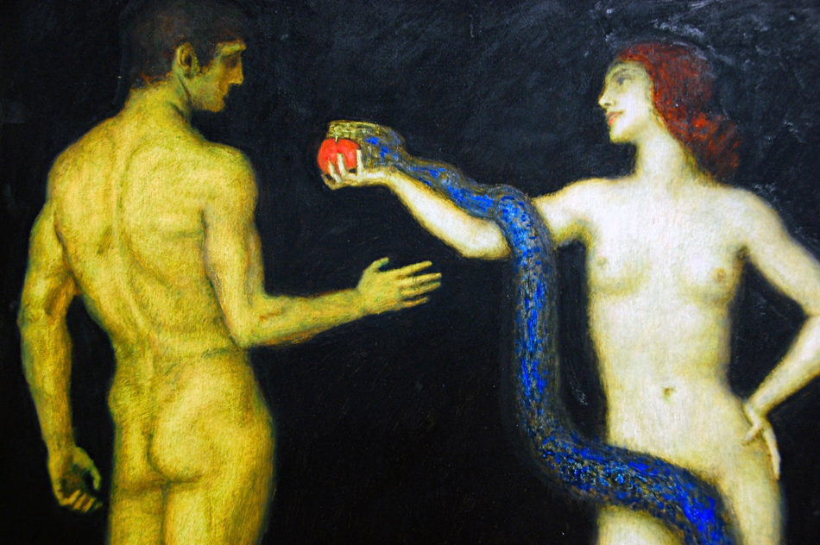
Adam and Eve
They had everything, could do anything they wanted, living in what one could consider Utopia. Only restriction: it was forbidden to bite into the apple of the forbidden tree. This is what Eve does, she is tempted by what the snake tells her and take a bite and then gives it to Adam. Temptation and curiosity is in fact one of the elements that can lead to the loss of everything, such as being banned from heaven, and results in dystopia.
https://commons.wikimedia.org/w/index.php?curid=23032696

Slide 6
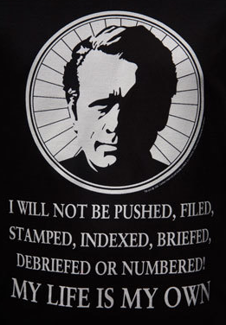
The prisoner (1964)
The prisoner is an English TV series, 17 episodes of 52 minutes, written by George Markstein and Patrick McGoohan. The story takes place in an unknown village in which an English spy, number 6, has been put after having resigned from his work. The place in which he is, looks utopian (everything looks idyllic, things are free or cheap, everybody is kind). This is how utopia is shown. Where dystopia come in is for the purpose of this place, to extract and know what number 6 retains. There are different tests in which he will not only succeed in hiding the information from them but will eventually outplay the tests. Every single time number 6 tries to escape, a white floating ball will come and send him back or will be around to remind him that he cannot escape. This is why the name of the series is The prisoner, even if you want to escape, you will have to stick with the “Utopian world”.
www.alamy.com/ID:DY4YPX

Slide 7
Animal Farm
The early apples were now ripening, and the grass of the orchard was littered with windfalls. The animals had assumed as a matter of course that these would be shared out equally; one day, however, the order went forth that all the windfalls were to be collected and brought to the harness-room for the use of the pigs. At this some of the other animals murmured, but it was no use. All the pigs were in full agreement on this point, even Snowball and Napoleon.
At the beginning all the animals are equal, underfed and fed up with Mr Jones, the Farmer of the farm. This situation leads to a rebellion, Mr Jones, his wife and the workers of the farm are expelled by the united animals. The pigs become the masters of the farm and run it. The other animals comply because they fear the return of Mr Jones. They are still underfed but feel secure because they know that the pigs are the masterminds that allowed to stop Mr Jones when he tried to take over the farm again and they are not beaten anymore. But this glimpse of utopia will soon turn back to dystopia except for the pigs who start behaving like humans. So in some circumstances, Utopia only exists from the dystopia of the others.
http://www.gutenberg.net.au/ebooks01/0100011h.html

Slide 8
Pandora’s box
​As the name suggest, Pandora’s Box belonged to Pandora, the first mortal woman, crafted by Hephaestus from clay, given life by Zeus, and imbued with characteristics by the other gods of Mount Olympus.
Pandora was designed to be the wife of the Titan Epimetheus, and Pandora brought with her to the marriage a box given to her by Zeus, although Zeus had told her that the box was not be opened.
​Pandora was not a gracious gift from the gods to Epimetheus though, for Zeus had created Pandora to punish mankind.
Epimetheus’ brother, Prometheus had stolen the secret of fire from the workshop of Hephaestus, and given it to man so that they would never be cold again, and Prometheus had also taught man how to make sacrifices so that the best meat of the sacrificial animals were kept for themselves, rather than the gods.
For these crimes, Prometheus would be punished, for he would spend eons chained to a mountain in the Caucasus’s, but Pandora was part of a more convoluted plan by Zeus to punish man.
Suddenly, a little voice comming out of the box, conviced Pandora to release it. That little voice was hope. And it’s words were : « Without me mankind is lost, I am Hope ».
Pandora’s box takes place in a utopian world, where everything is fine, everybody is happy and there are no diseases, there is no hate, only positive emotions (being sad is there too) rule the world. This changes when the Zeus gives Pandora, the first mortal women to come to the world, a special box in which he puts all the forces of evil and suffering he had created. Zeus tells her that it was to remain closed and shouldn’t be opened under any circumstances. But the Greek gods wanted it to be opened and so, Zeus gifted Pandora the trait of curiosity. Combined with Aphrodite’s gift: feeling deep emotions, this was enough to push Pandora to open the box and release its content into the world. In this box, there was only one positive force, it hadn’t had time to come out after that Pandora had shut the box, but without it, the world is lost, this force was hope. It is an essential force that helps us through hard times. This is why I think that without hope we would live in constant dystopia because Utopia can never be complete, and it is generally short. This is why hope allows us to live through life having an idea, a glimpse, a wonder about how a utopian world can be made, lived in.
https://www.greeklegendsandmyths.com/pandoras-box.html

Slide 9
Candid - Voltaire
"There is a concatenation of events in this best of all possible worlds: for if you had not been kicked out of a magnificent castle for love of
Miss Cunegonde: if you had not been put into the Inquisition: if you had
not walked over America: if you had not stabbed the Baron: if you had
not lost all your sheep from the fine country of El Dorado: you would
not be here eating preserved citrons and pistachio-nuts."
This is the ending of the book Candide, written by Voltaire. The reason why I chose this extract is to show that dystopia can sometimes give the illusion of utopia but in the end is just another version of a mediocre, negative and unwishful life. The aim of the book is in the end to give the message that it is unnecessary to go round the world to find your happiness.
http://www.fullbooks.com/Utopia1.html

Slide 10
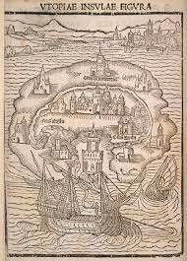
Utopia, conclusion
To conclude, it does seem practically impossible for utopia to exist without a minimum of dystopia. Thomas More who created the word utopia when he wrote his book in 1516, saw it as an island, isolated from outside influences. It is a wonderful thought that utopia would be possible but it does seem that human nature proves again again that it is never possible for long without dystopia sneaking in.

